Slide 1
Digital Game Store Management System
CSE 212: Database Systems - Project
Md. Masnun
ID: 18201013
Section: A1

Slide 2
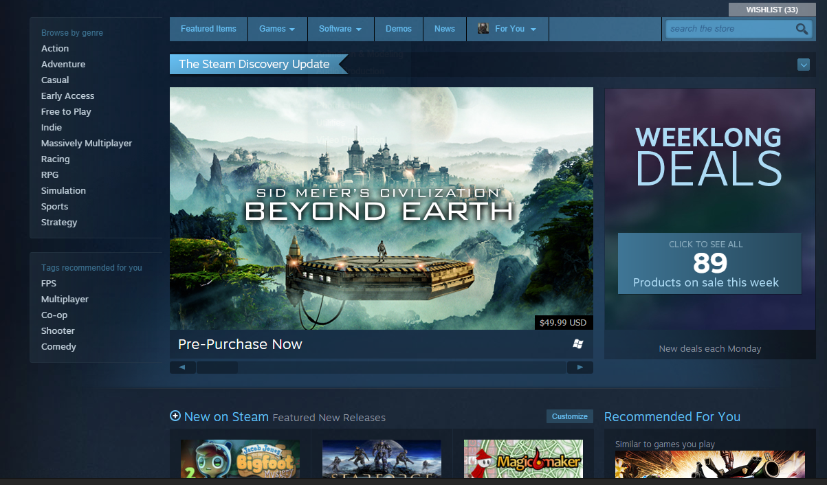
Overview
The purpose of this Database Management System is to manage all the necessary data of a digital video game store, such as product information, transactions, consumer accounts, game developers and publishers etc.

Slide 3
Features
This database management system comes with the following features.
Organized and efficient cataloguing of all available games
Accurate calculation and management of sales and revenue
Readily providing necessary data for all users
Creating an easy to use, stable and secure platform for publishing and purchasing games online

Slide 4
Database Model and Relations
Relational Model will be used for this database management system, with the following relations:
Games (Contains data of the store’s games)
Players (Contains data of player accounts)
Developers (Contains data of game developers)
Publishers (Contains data of game publishers)
Reviews (Contains data of game reviews)

Slide 5
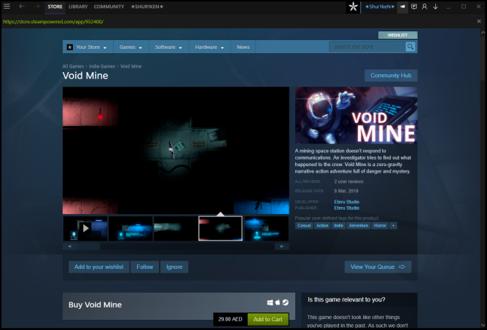
“Games” relation
Contains the following attributes:
Game Name
Price
Genre
Release Date
Average Rating
Developer
Publisher
Monthly Sales
Total Sales

Slide 6
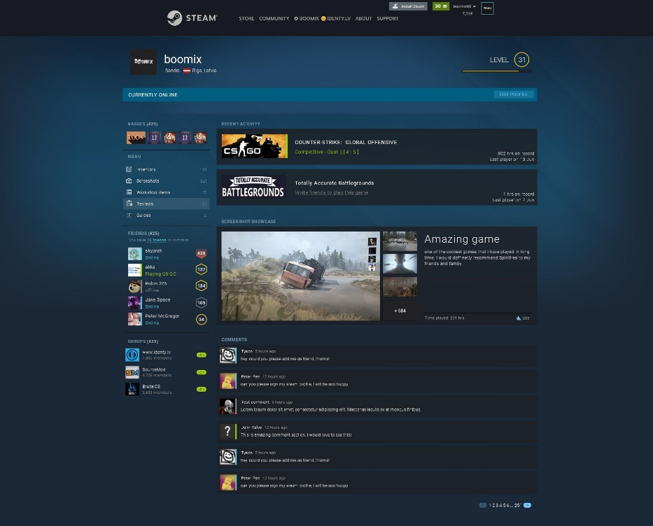
“Players” relation
Contains the following attributes:
Account Name
Account ID
Email Address
Balance
Owned Games
Most Recent Purchase

Slide 7
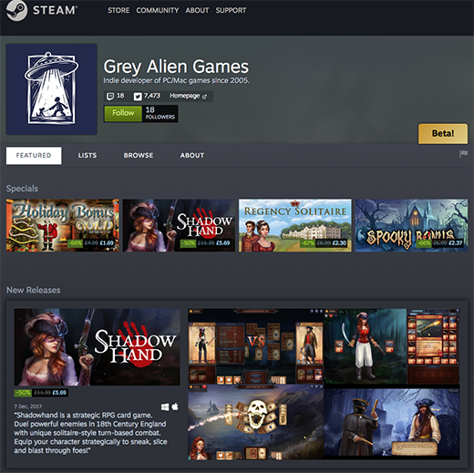
“Developers” relation
Contains the following attributes:
Developer Name
Developer ID
Developer Website
Developed Games
Monthly Revenue
Total Revenue

Slide 8
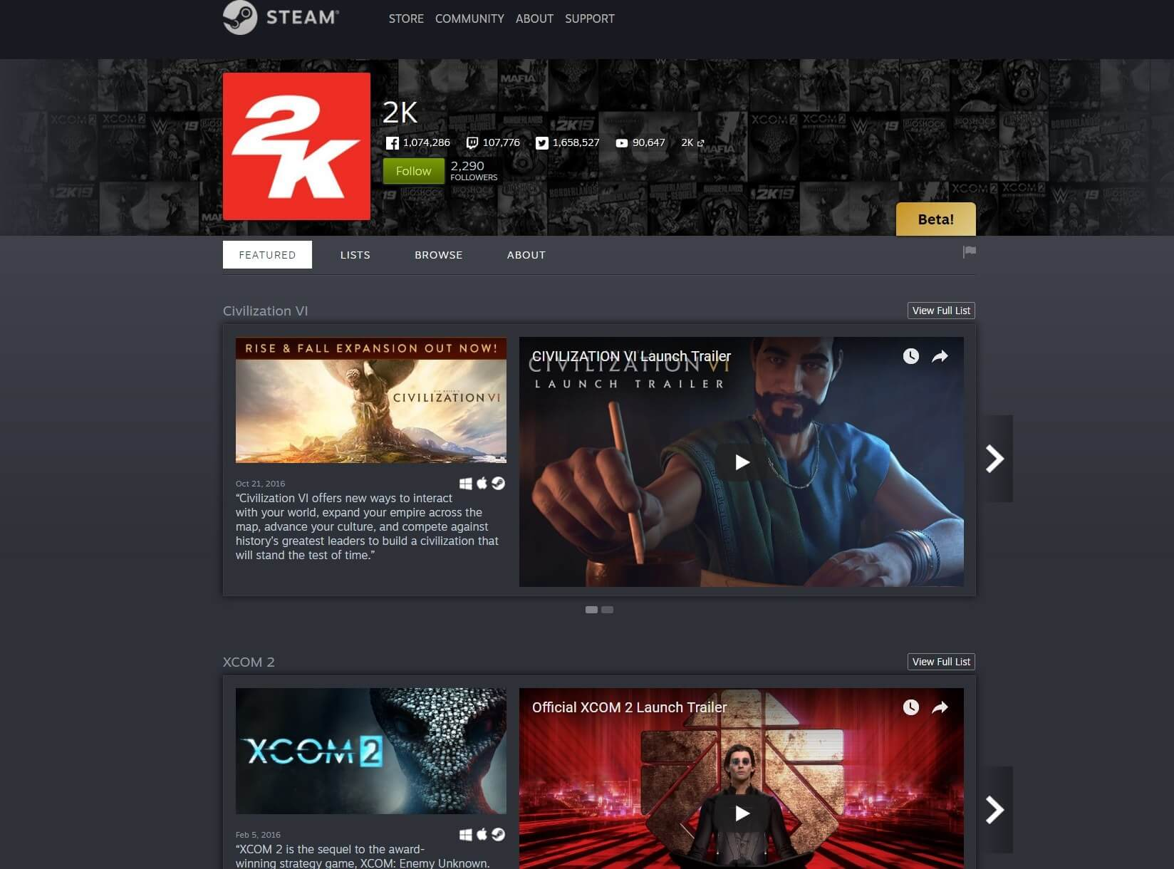
“Publishers” relation
Contains the following attributes:
Publisher Name
Publisher ID
Publisher Website
Supported Developers
Monthly Revenue
Total Revenue

Slide 9
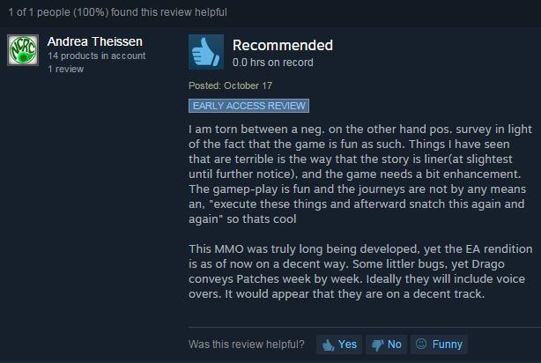
“Reviews” relation
Contains the following attributes:
Game Reviewed
Reviewer Name
Rating
Review Type (user or critic)
Review Date

Slide 10
Design (E-R DIAGRAM)
Transaction amount
buys
Players
Name
Balance
Owned Games
…
publishes
Publishers
Name
Website
Published Games
…
Games
Name
Price
Avg. Rating
…
owns
reviews
Reviews
Reviewer …………..
Rating
Reviewed Games
…
Developers
Name
Website
Developed Games
…
develops
reviews
hosted
rates

Slide 11
Conclusion
A Digital Game Store Management system would aid in organizing purchase and cataloguing of games through the digital store and would simplify and streamline the data management and transactions involved in the process. Thus, a digital game store management system would be very beneficial for the gaming industry.

Slide 12


